Slide 1
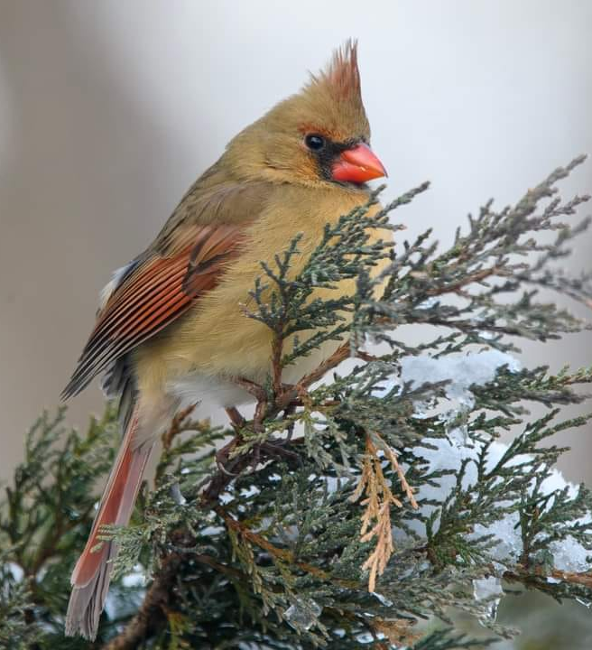
Behavior and Ecology of Northern Cardinals
Joanna Vondrasek
Research contributions from Annie Newell Fugate & Ezra Staengl
Photo credit: John Hines

Slide 2
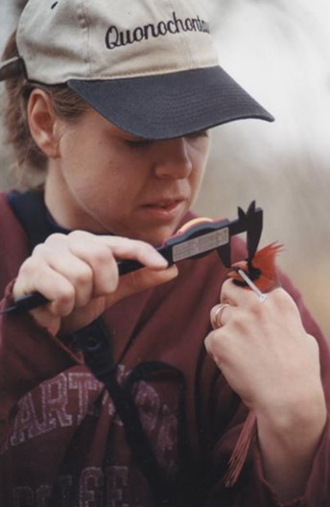
Research background
Dissertation research at Mason Farm Biological Reserve in Chapel Hill, NC (1997-2002)
Observations/Research with PVCC students in Charlottesville (2003-present)
c. 2002

Slide 3
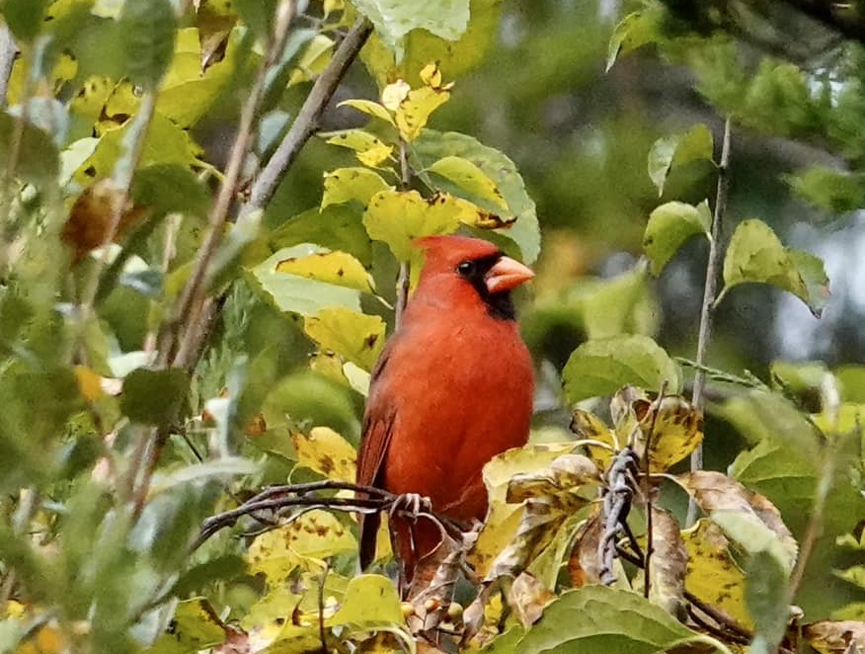
“Wander around Mason Farm and see what is interesting”
-- My graduate advisor when I arrived at UNC in 1997 interested in bird behavior, specifically cooperative hunting in Harris Hawks….
Photo credit: Ana Maria Allard

Slide 4

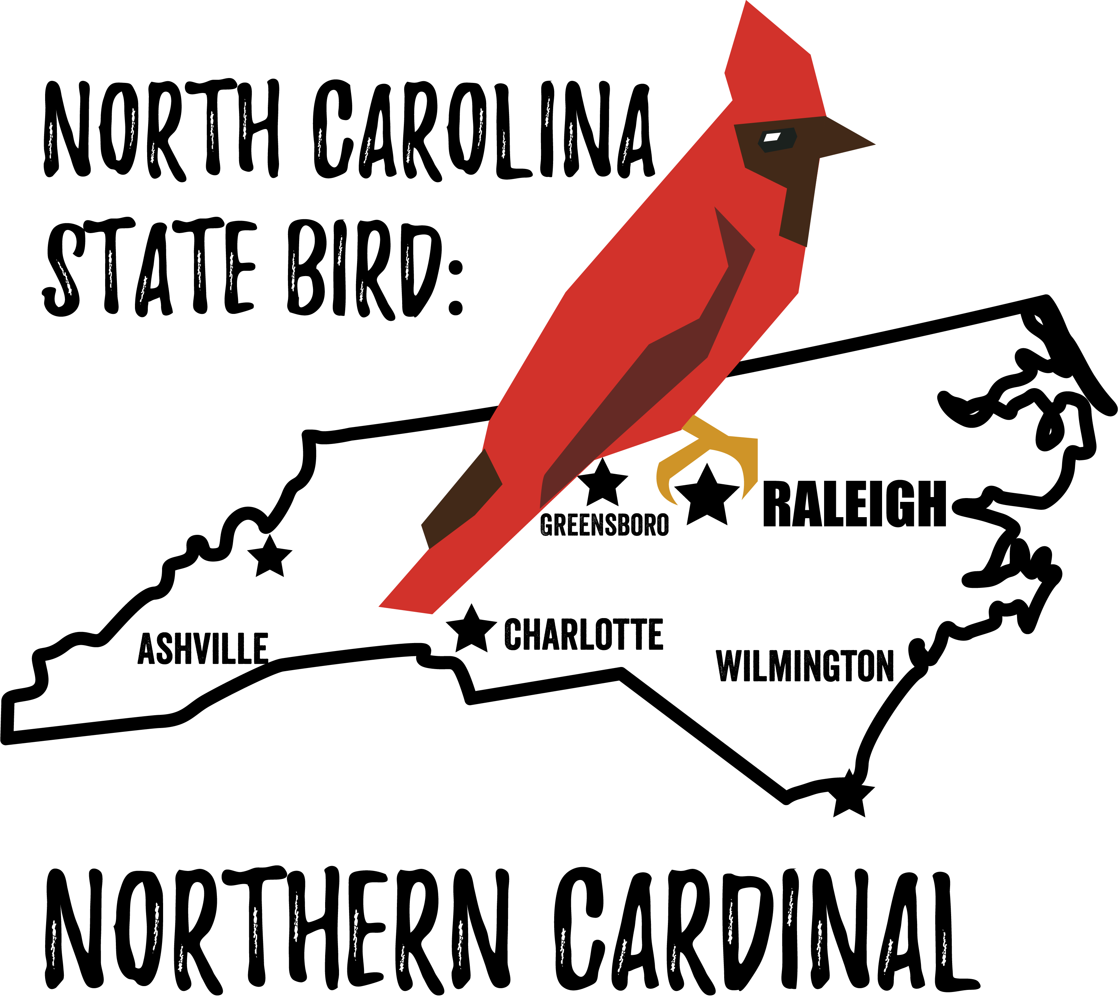
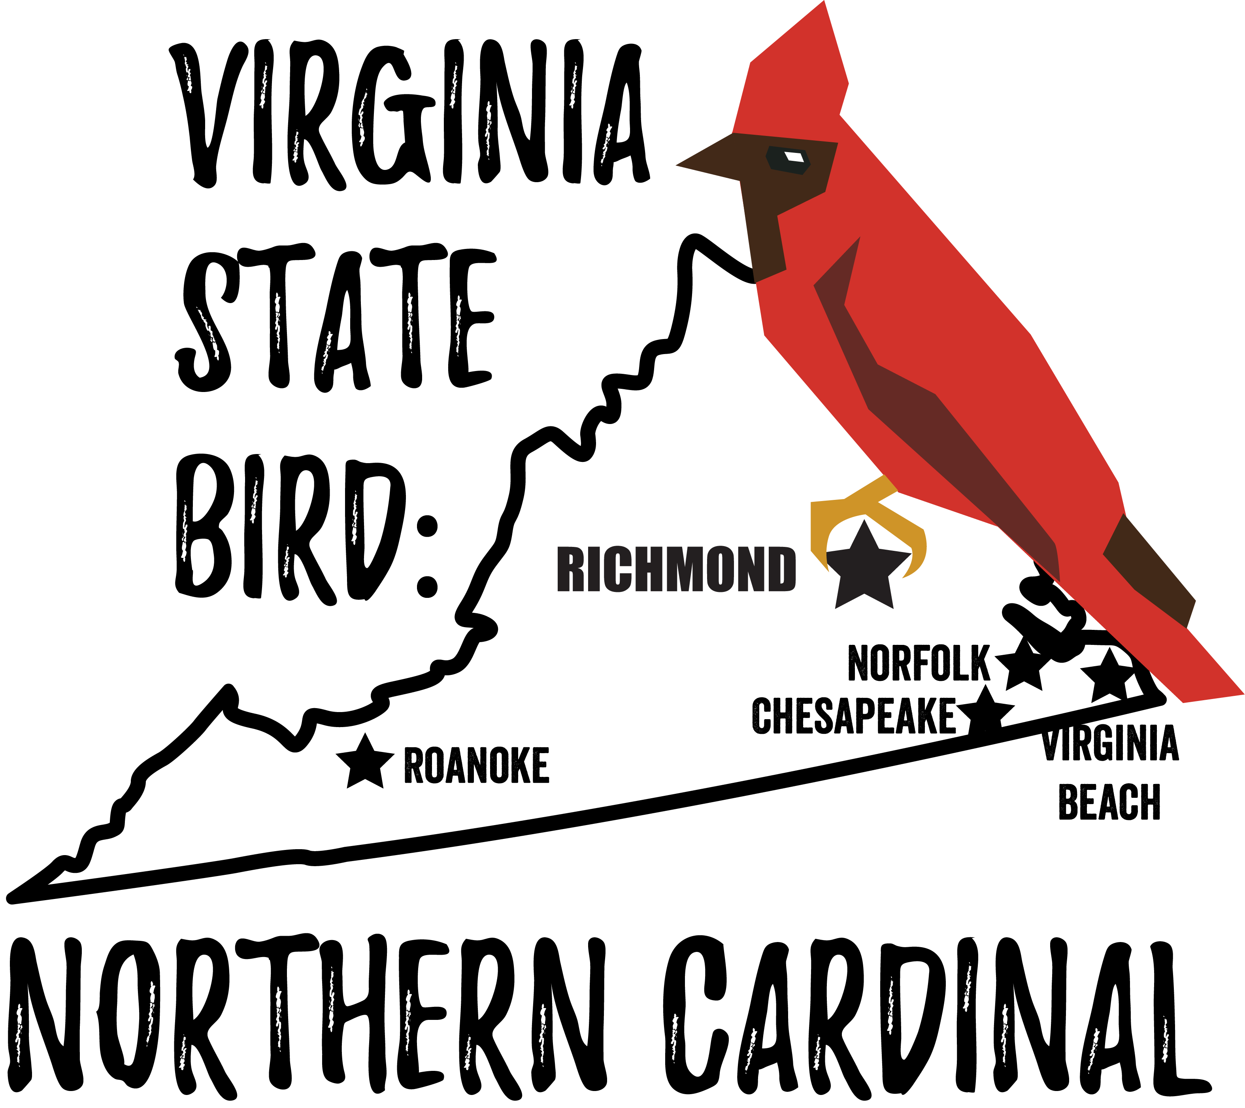
Unseen influences in my choice of research topic ?
My high school mascot…

Slide 5
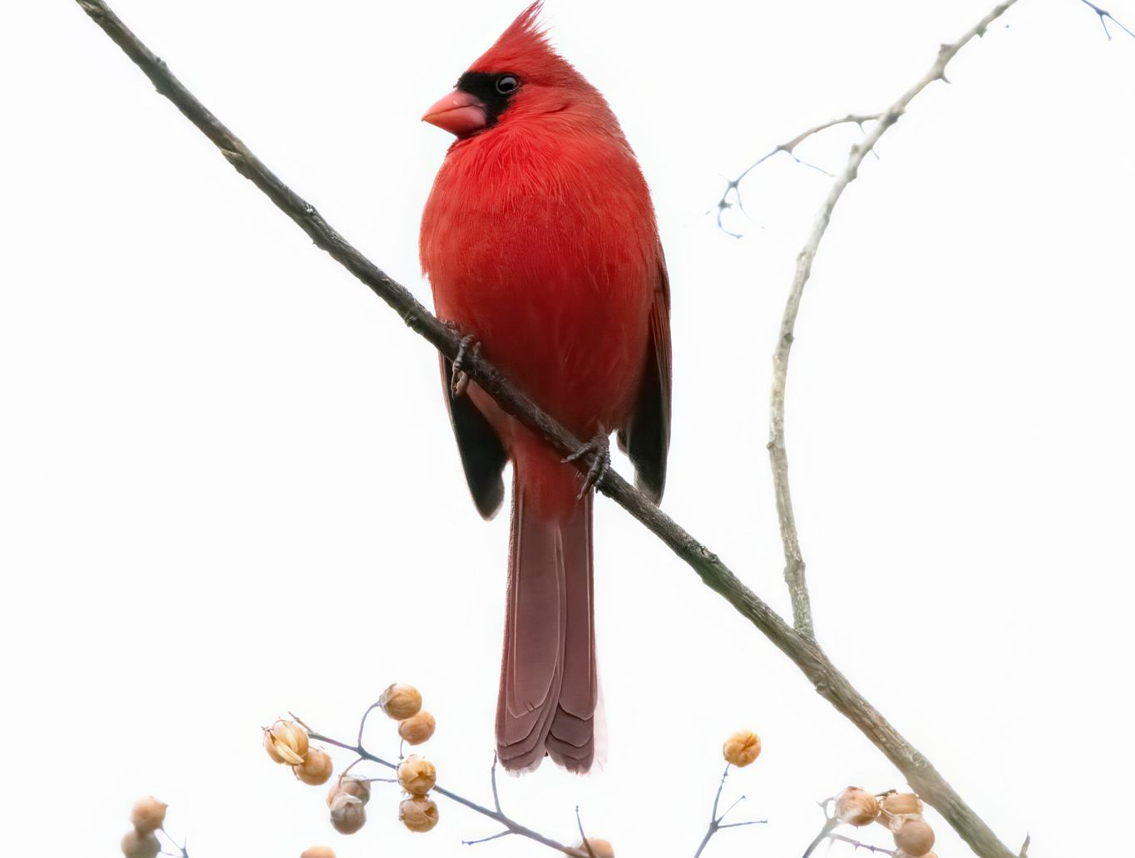
Who is singing?
Birdee birdee birdee!
Can you tell?
Why do both male and female cardinals sing?
https://www.inaturalist.org/observations/152627955
Photo credit: Taylor Horton

Slide 6
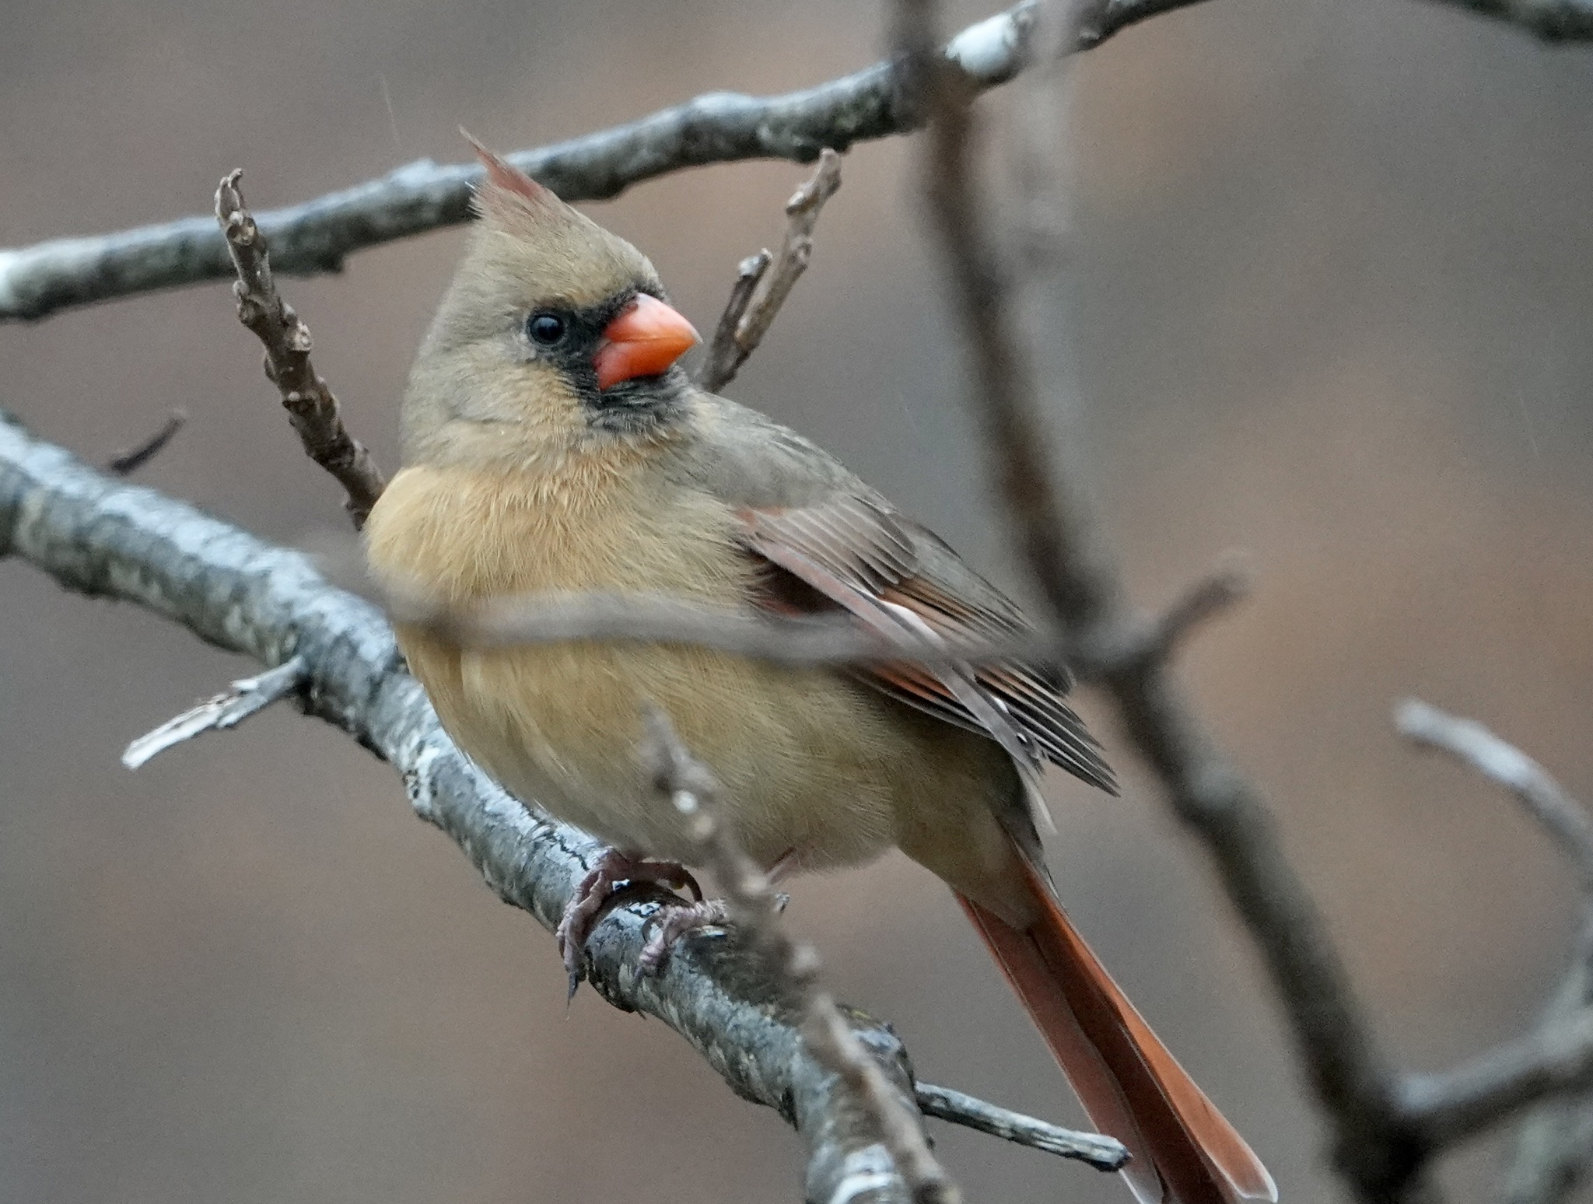
Who is singing?
Birdee birdee birdee!
Can you tell?
Why do both male and female cardinals sing?
Photo credit: Kim Beard

Slide 7
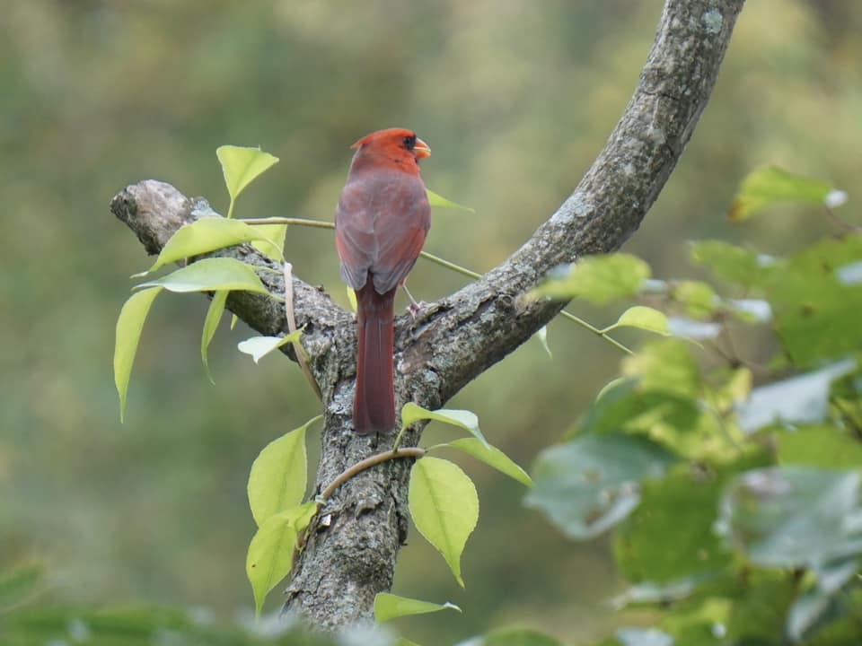
Key Findings from North Carolina
Summarize 5 years of research in two slides
Males and females have similar repertoire sizes
I could not detect any consistent differences by sex in song by ear, and only a few with acoustic analysis
Pairs respond aggressively to intruders of both sexes – and appear to distinguish between strangers and neighbors
Photo credit: Wendy Ann Guest
Vondrasek, J.R. 2003. The evolution of communication and territoriality in the northern cardinal (Cardinalis cardinalis).

Slide 8
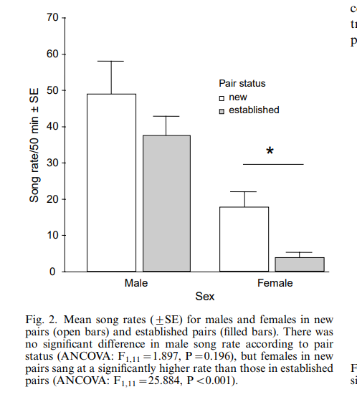
Females in newly established pairs sing at a much higher rate than females in established pairs
Males show similar trend, but not a significant difference.
Unclear if there is an interaction between age and pair-status
Vondrasek, J.R. 2006. Social factors affect the singing rates of female northern cardinals Cardinalis cardinalis. Journal of Avian Biology 37: 52-57

Slide 9
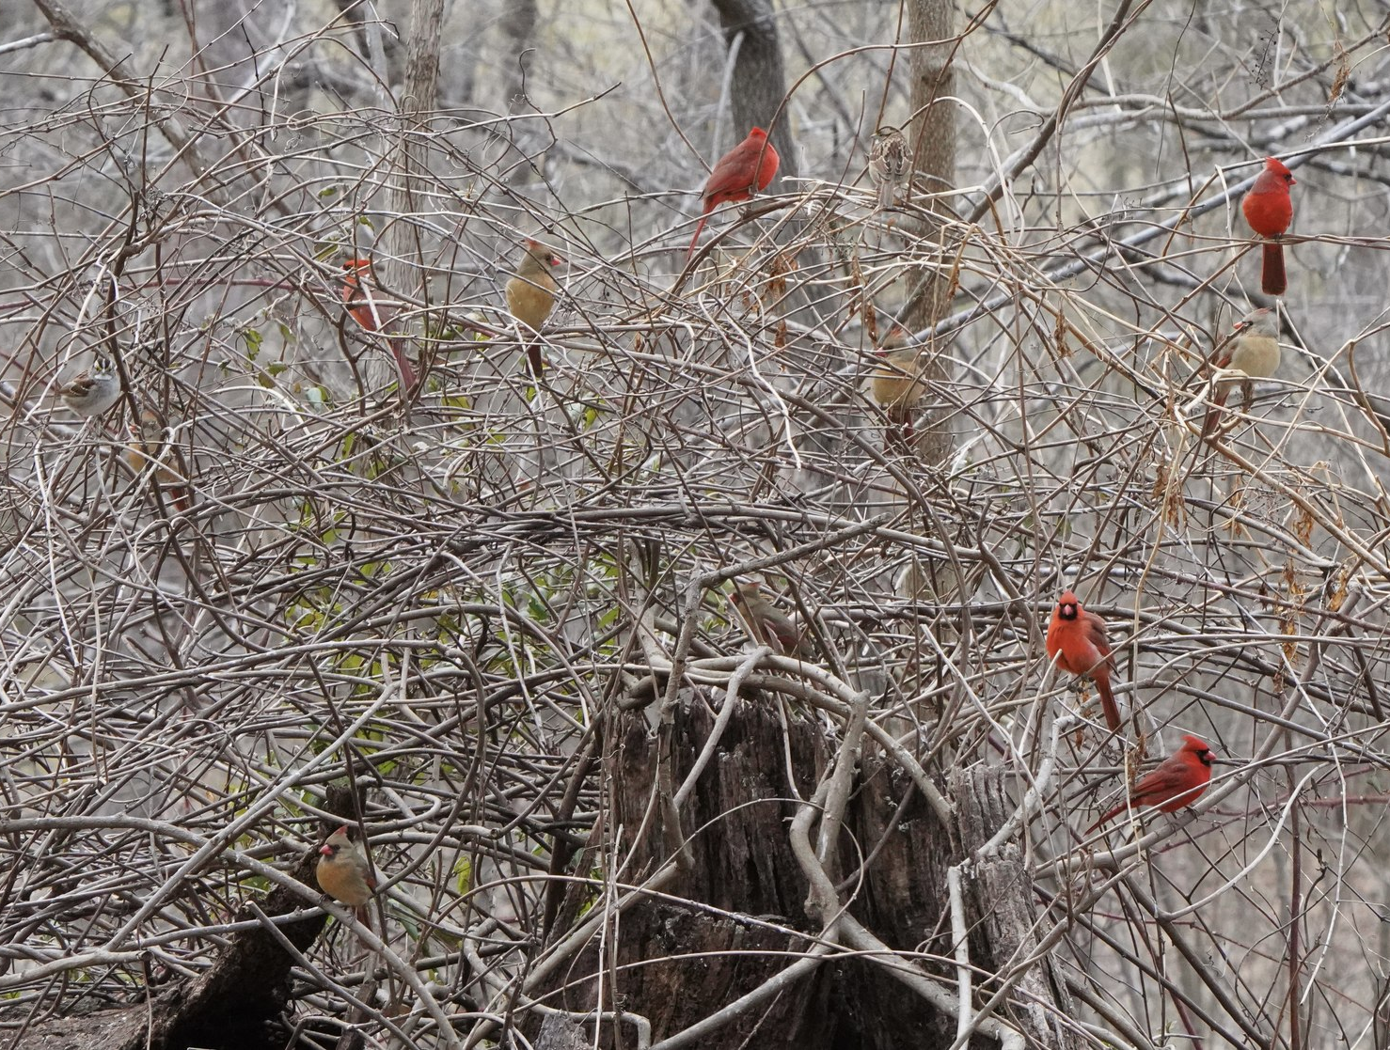
Flocking in the winter, but with retained dominance on summer territories
In North Carolina:
Males retain dominance at artificial feeding sites within their previous summer territories
Females probably do as well (less clear)
Photo credit: Kim Beard
Vondrasek, J.R. 2003. The evolution of communication and territoriality in the northern cardinal (Cardinalis cardinalis).

Slide 10
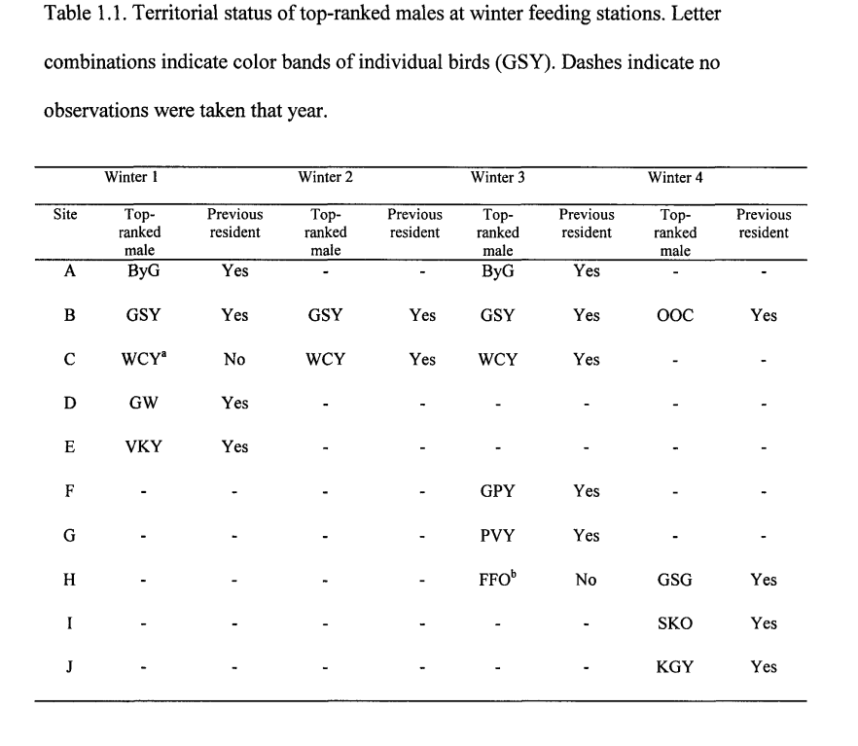
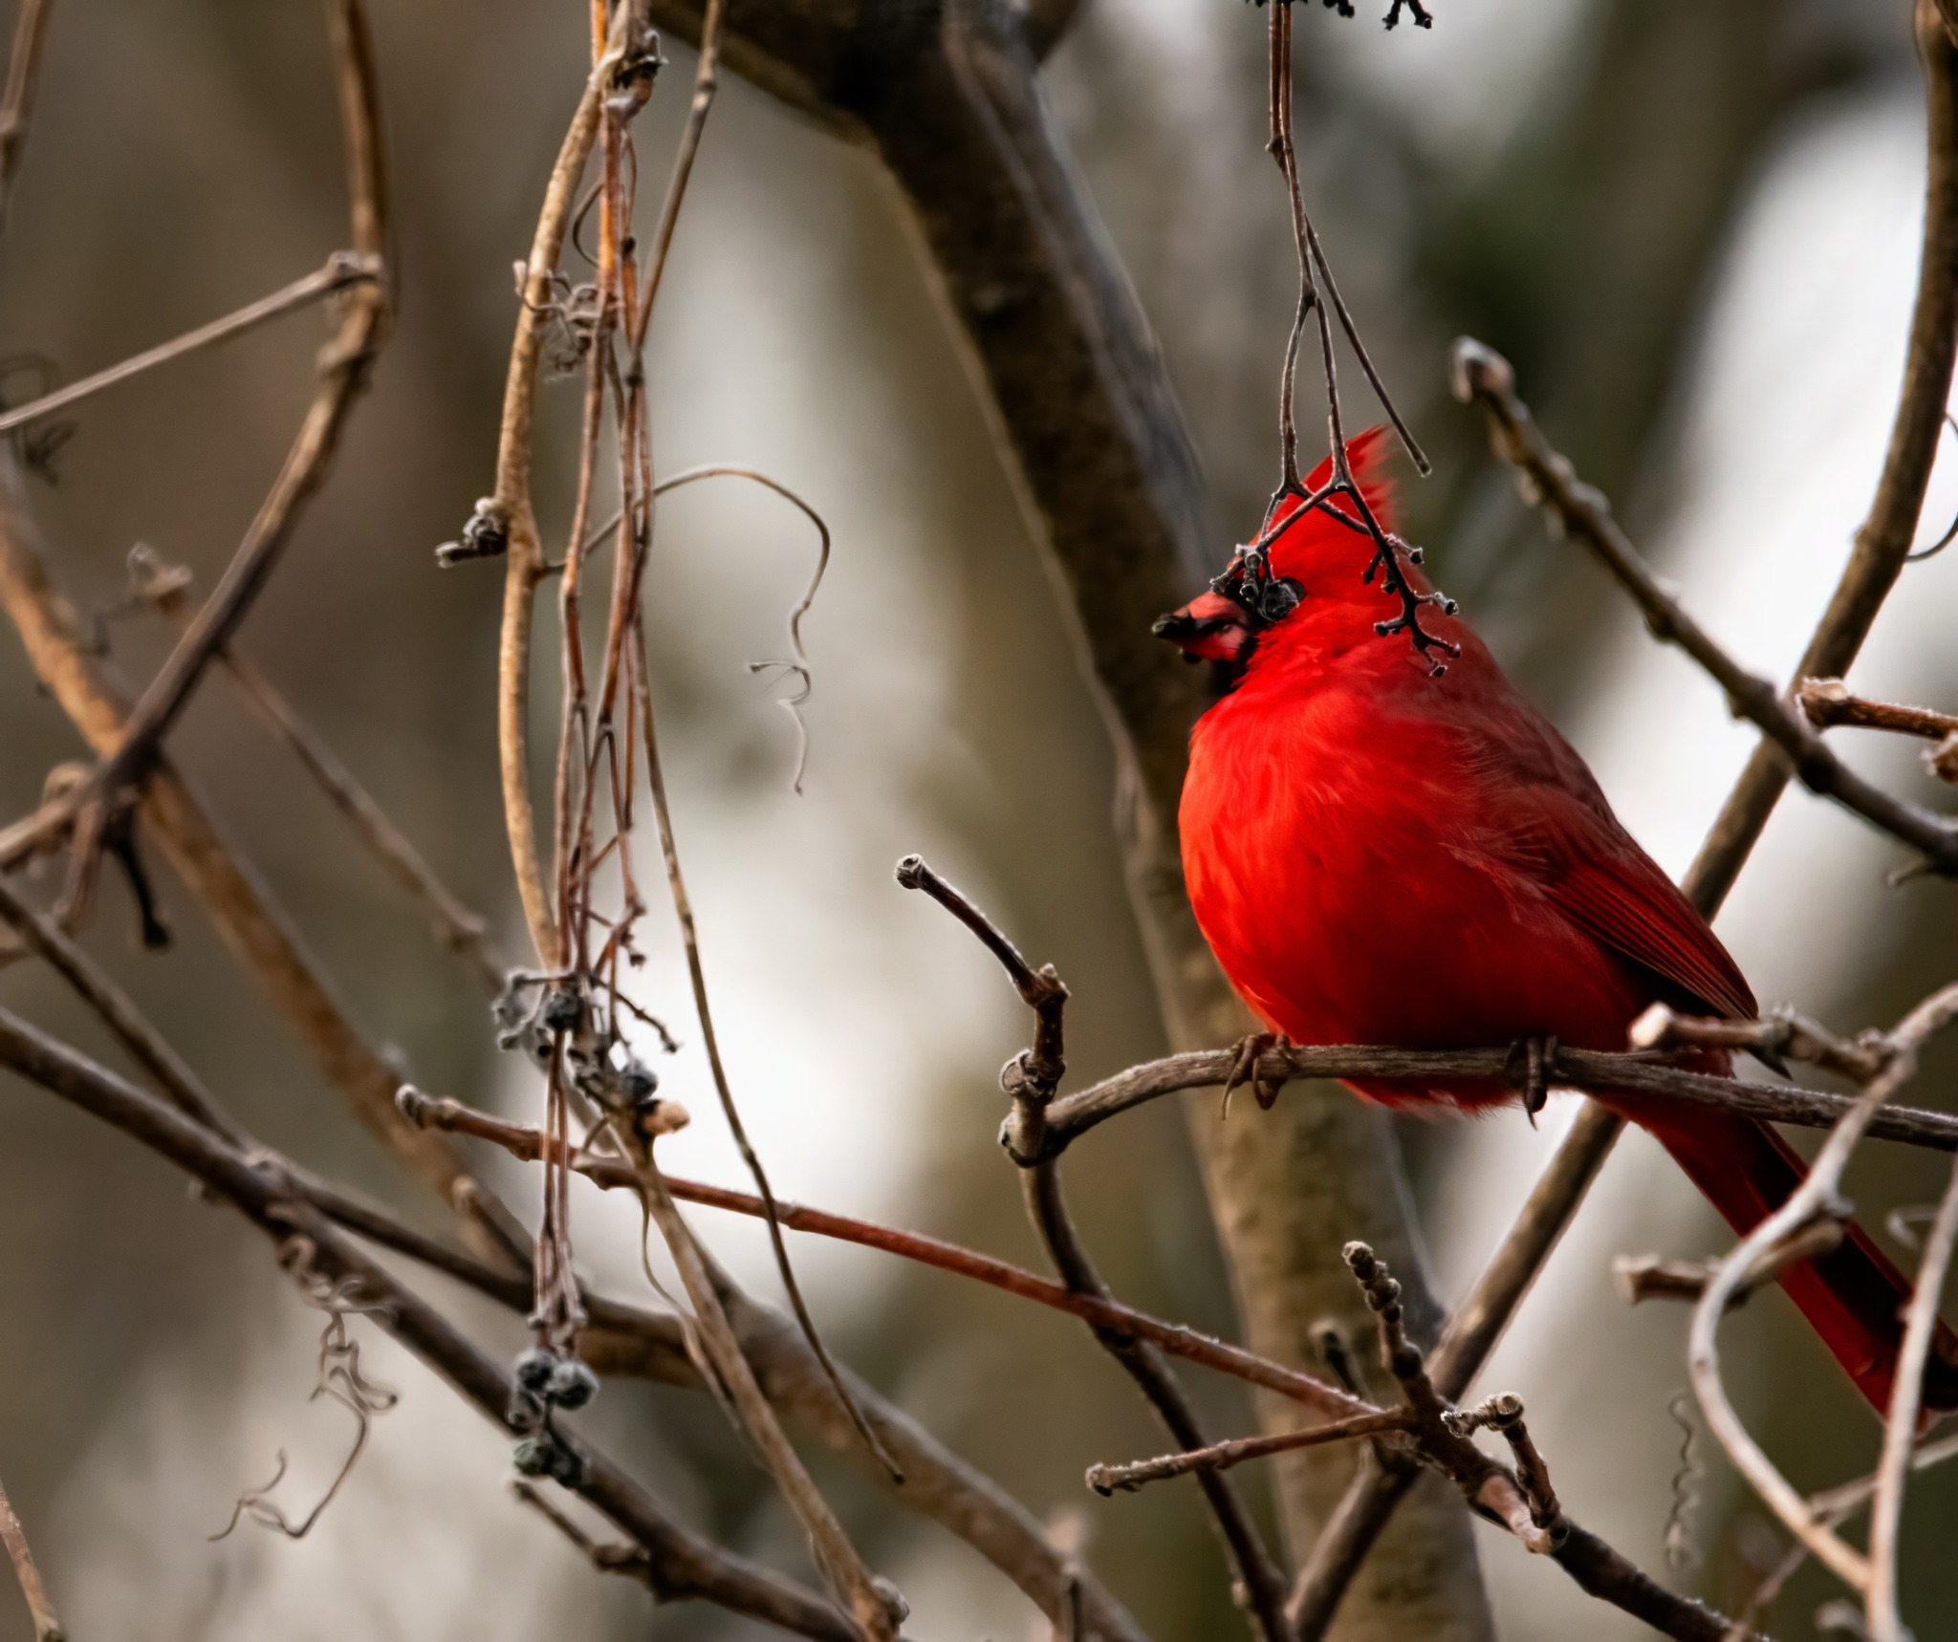
Photo credit: Taylor Horton
Vondrasek, J.R. 2003. The evolution of communication and territoriality in the northern cardinal (Cardinalis cardinalis).

Slide 11
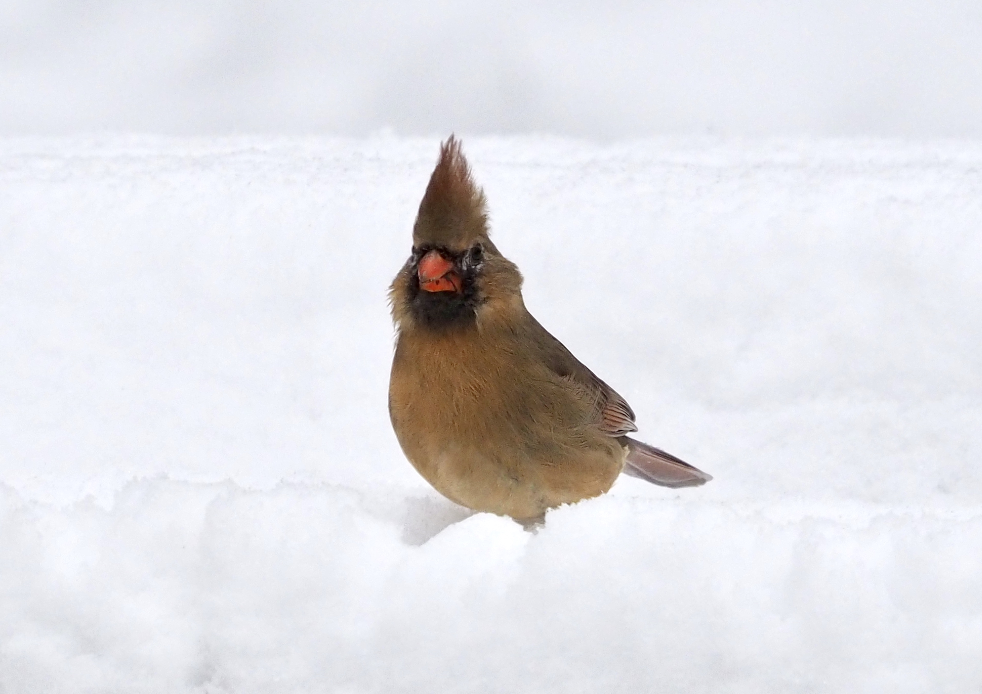
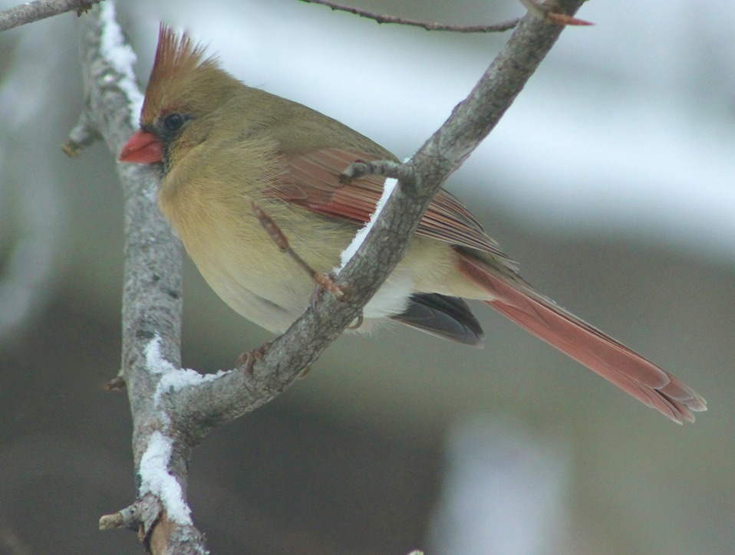
Winter Diet of Cardinals in the VA Piedmont
Ezra Staengl’s Capstone Research at PVCC in Spring 2022
Photo credit: Cathy Good
Photo credit: JoAnn Dalley
Questions:
What do cardinals eat in the winter in Central Virginia?
Does their diet differ between rural and urban locations?
Staengl, E.. and Vondrasek, J.R. Winter Diet of the Northern Cardinal (Cardinalis cardinalis) in Central Virginia: A comparison of a rural and an urban site (in review)

Slide 12
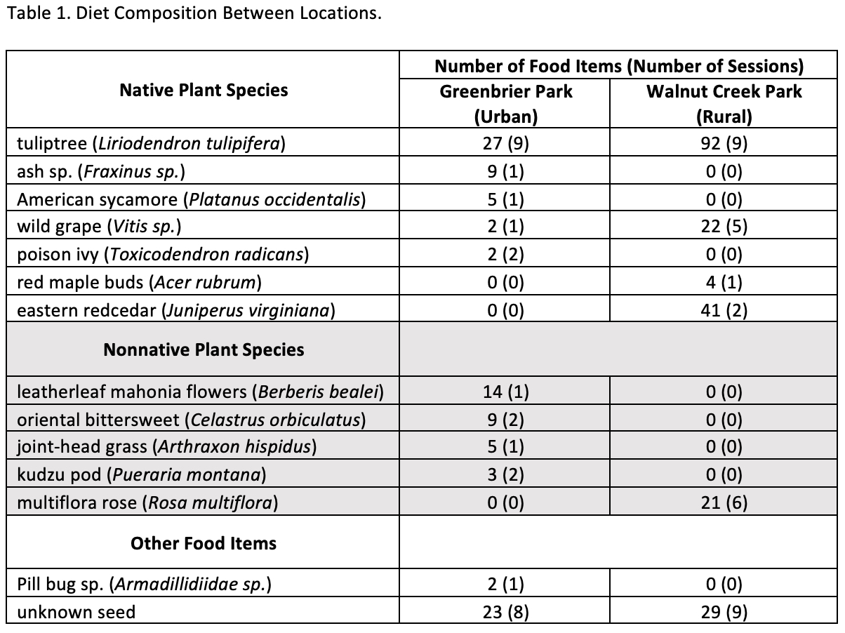
Comparison of diet between Greenbrier Park in Charlottesville and Walnut Creek Park in Albemarle County
Staengl, E. and Vondrasek, J.R. Winter Diet of the Northern Cardinal (Cardinalis cardinalis) in Central Virginia: A comparison of a rural and an urban site (in review)

Slide 13
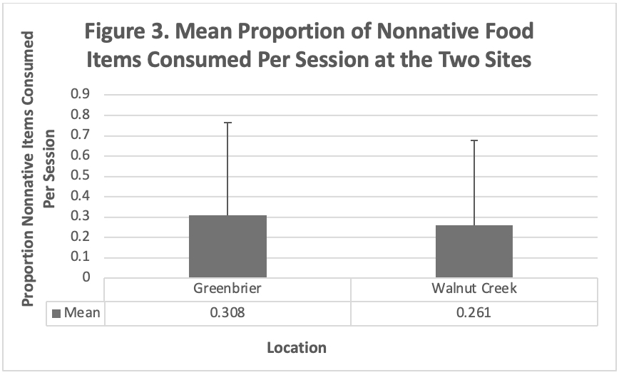
Key Findings
Almost entirely plant-based diet
Similar proportions of native/nonnative plants consumed
Little overlap between Greenbrier (urban) and Walnut Creek (rural)
  Tuliptree, wild grape only common food sources at both locations
Some invasives eaten in both locations. Of note:
  Leatherleaf mahonia in Greenbrier (urban)
  Multiflora rose in Walnut Creek
Staengl, E. and Vondrasek, J.R. Winter Diet of the Northern Cardinal (Cardinalis cardinalis) in Central Virginia: A comparison of a rural and an urban site (in review)

Slide 14
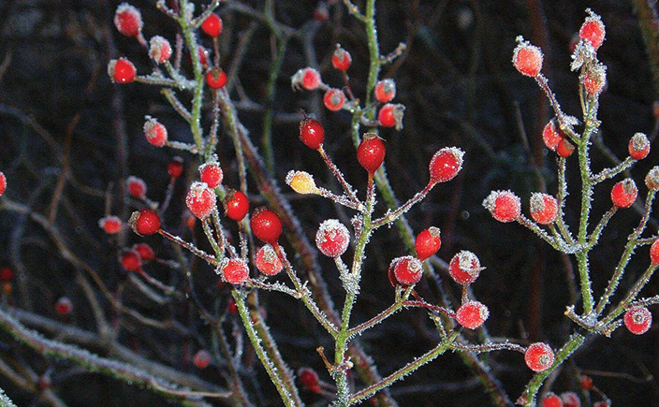
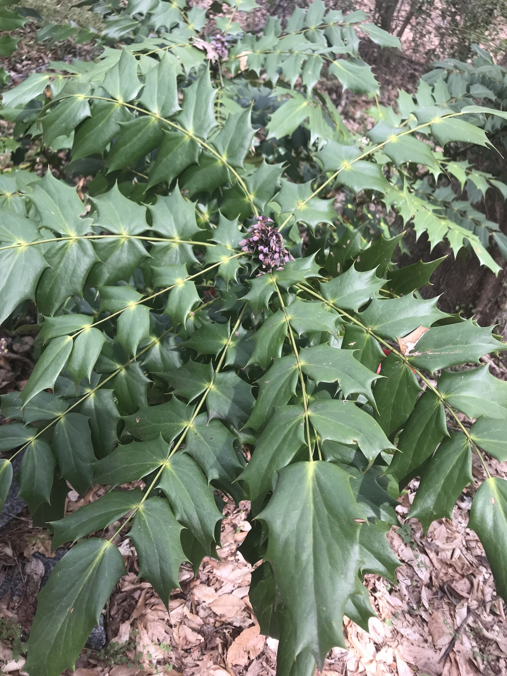
Some of the nonnative plants consumed
Multiflora rosehips in winter
Leatherleaf mahonia (photo in C-ville near CHS). Flowers were eaten
Photo credit: https://www.conngardener.com/multiflora-rose/
Photo credit: lboogie iNaturalist)

Slide 15
Behavioral observations – Virginia 2005-present
General theme: overlap between behaviors thought to be confined to a single sex
Photo credit: JoAnn Dalley

Slide 16
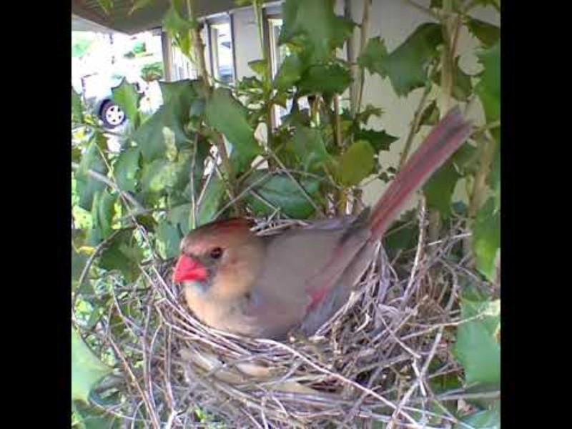
Female singing on nest, male delivering food
Video credit -- YouTube: @rosieandred-northerncardin2991
Indiana, May 1, 2021

Slide 17
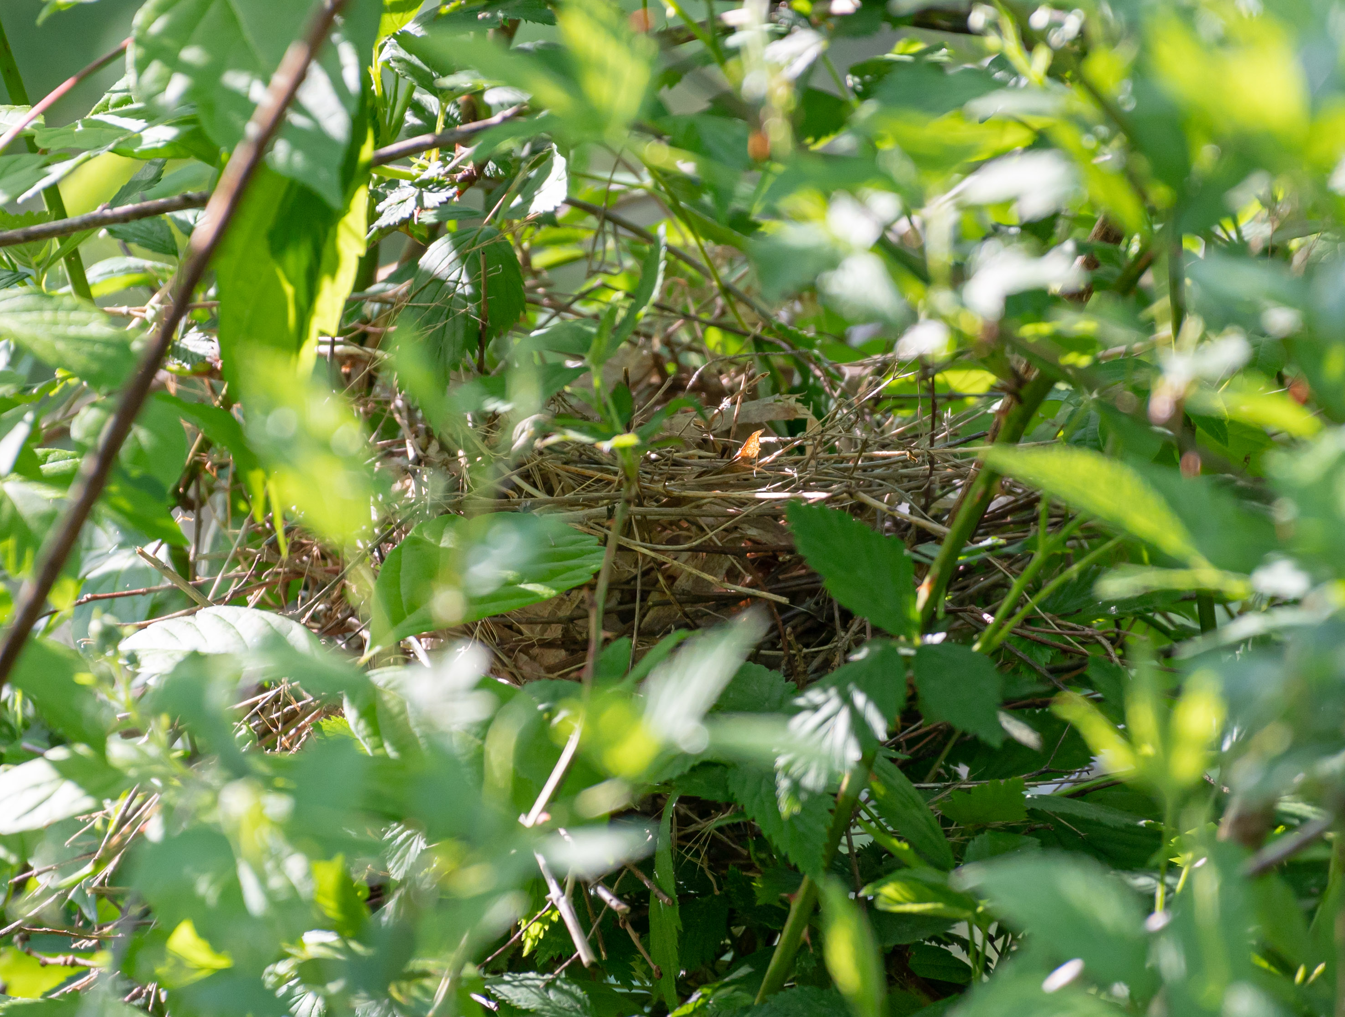
Males incubating eggs?
Females singing to indicate this need?
Early (cold) April (2005) in Belmont…
Female sang from nest and flew off
Male immediately flew in and sat on nest for a short time
Nest failed a few days later
Photo credit: Will Kurtz
Vondrasek, J.R. 2006. Nest-sitting by a male North Cardinal (Cardinalis cardinalis). The Raven 77(1):13-15.

Slide 18
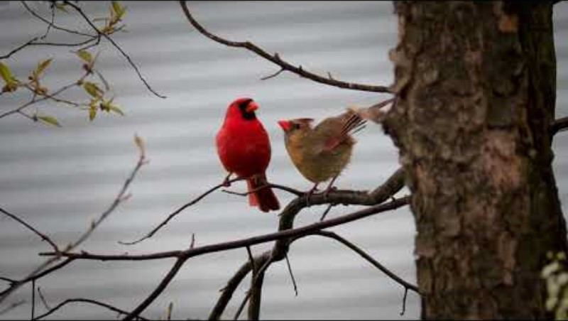
Courtship display is connected to song in both sexes prior to copulation
Youtube: © My Backyard Friends
Vondrasek, J.R. 2023. Observations of Coordinated Song, Courtship Display, Courtship Feeding, and Copulation in Northern Cardinals (Cardinalis cardinalis) in Virginia. Northeastern Naturalist 30(4), N71-N74

Slide 19
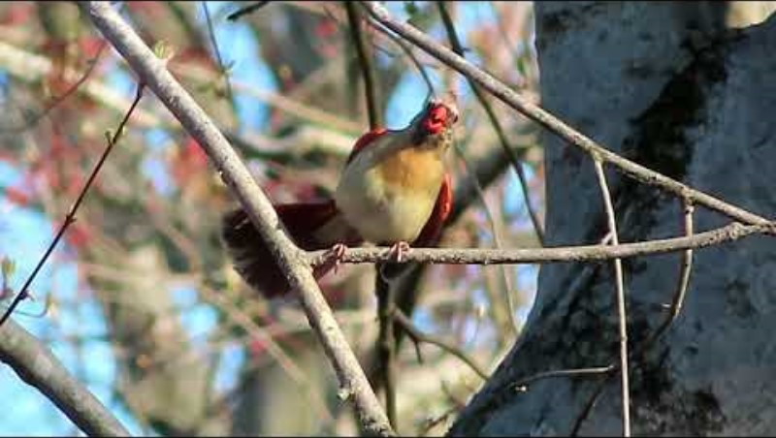
Video Source: Youtube – Davegillplaysguitar New Jersey, April 2021

Slide 20
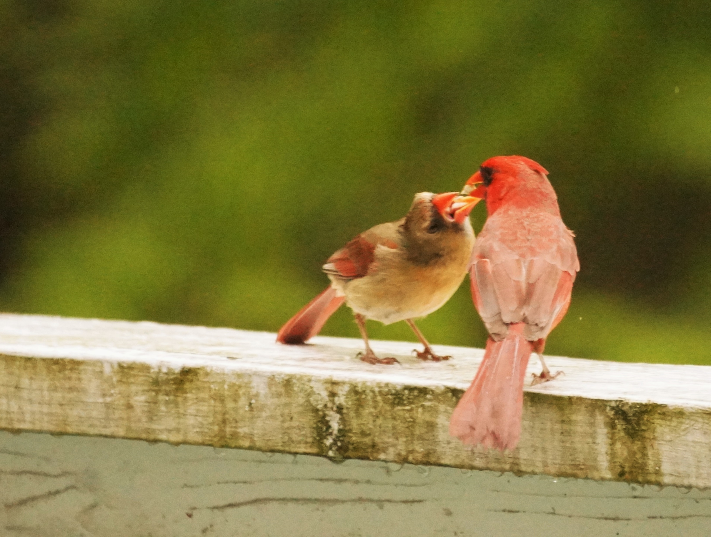
Courtship feeding
Who is feeding whom?
Observed a female delivering food to a male in my yard in Belmont
Not previously reported
Photo credit: Chris Anderson-Hoke
Vondrasek, J.R. 2023. Observations of Coordinated Song, Courtship Display, Courtship Feeding, and Copulation in Northern Cardinals (Cardinalis cardinalis) in Virginia. Northeastern Naturalist 30(4), N71-N74

Slide 21
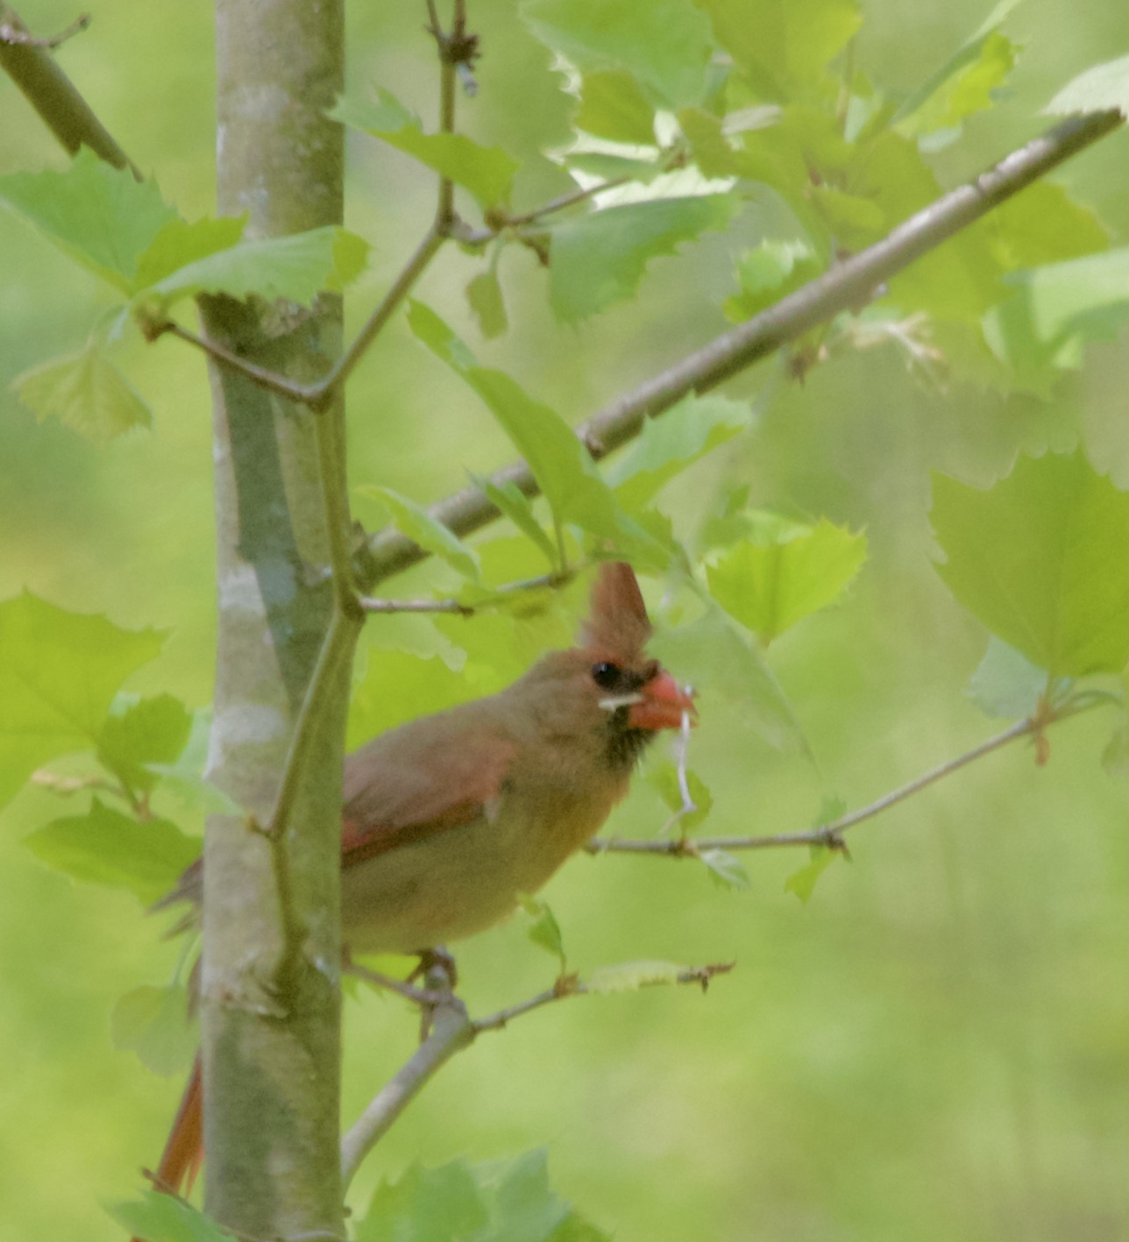
Conclusions
Despite pronounced sexual dichromatism, a lot of similarities in behavior between males and females
Even a well studied, common bird like the cardinal can continue to yield surprises and insight into bird behavior and ecology
Keep your eyes and ears open
Photo credit: JoAnn Dalley

Slide 22
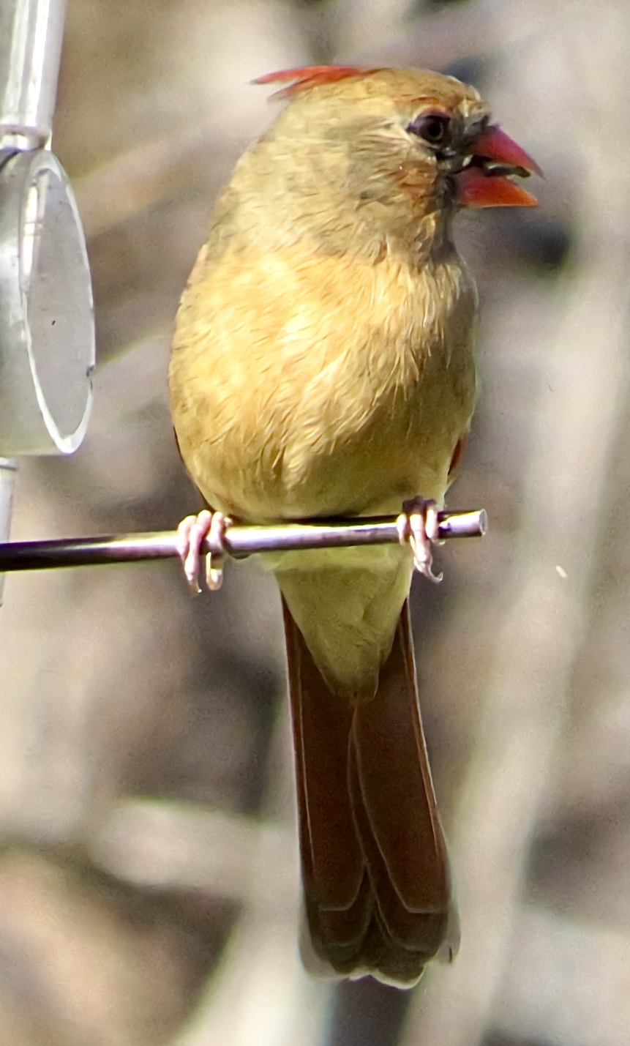
Acknowledgements
North Carolina: Haven Wiley, Annie Newell Fugate, Caroline Stahala, Guian McKee
Virginia: Ezra Staengl, Guian McKee, PVBC Club Members for contributing photos!
Photo credit: Doug Campbell

